Slide 1
Agenda
Object Detection Task
Naïve Approach: Sliding window
Region based CNN
Fast Region based CNN
Faster Region based CNN
Single Shot Multi Box Detector

Slide 2
Object Detection

Slide 3
Naïve Approach

Slide 4
Naïve Approach

Slide 5
Naïve Approach

Slide 6
Naïve Approach

Slide 7
Naïve Approach

Slide 8
Naïve Approach

Slide 9
Naïve Approach

Slide 10
Naïve Approach
Computationally expensive
Sliding windows may contain no objects at all

Slide 11
Region Proposals
There are techniques in classical computer vision which can be used to identify portions of an image that have a higher chance of containing an object
One of the most common algorithm to compute region proposals is known as “Selective Search”
Tries to find similar regions based on
Color gradient
Shape etc

Slide 12
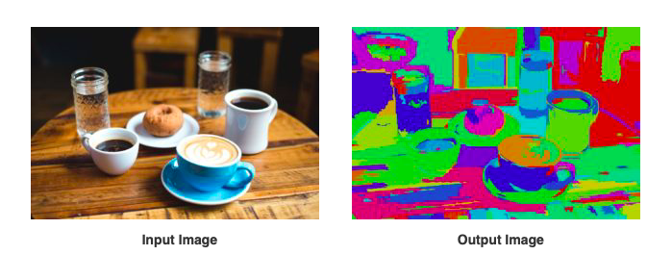
Region Proposals

Slide 13
Region Proposals
Add bounding boxes to segmented image

Slide 14
Region Proposals
Add bounding boxes to segmented image

Slide 15
Region Proposals
Add bounding boxes to segmented image
Group adjacent boxes based on similarity

Slide 16
Region Proposals
Add bounding boxes to segmented image
Group adjacent boxes based on similarity
Repeat

Slide 17
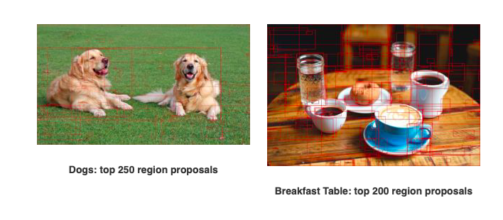
Region Proposals

Slide 18
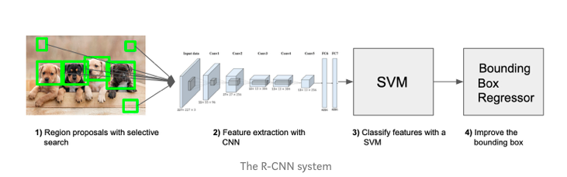
Region Based CNN (RCNN)
RCNN use selective search to choose regions to be fed into a classifier and regressor

Slide 19
Region Based CNN (RCNN)
RCNN use selective search to choose regions to be fed into a classifier and regressor
227*227 input, 5 conv layers, 4096 dim output
Around 2000 proposals are selected

Slide 20
Region Based CNN (RCNN)
RCNN use selective search to choose regions to be fed into a classifier and regressor
Around 2000 proposals are selected
These are then resized and pushed through a cnn

Slide 21
Region Based CNN (RCNN)
RCNN use selective search to choose regions to be fed into a classifier and regressor
Around 2000 proposals are selected
A separate classifier finds out the class associated with each proposal
These are then resized and pushed through a cnn

Slide 22
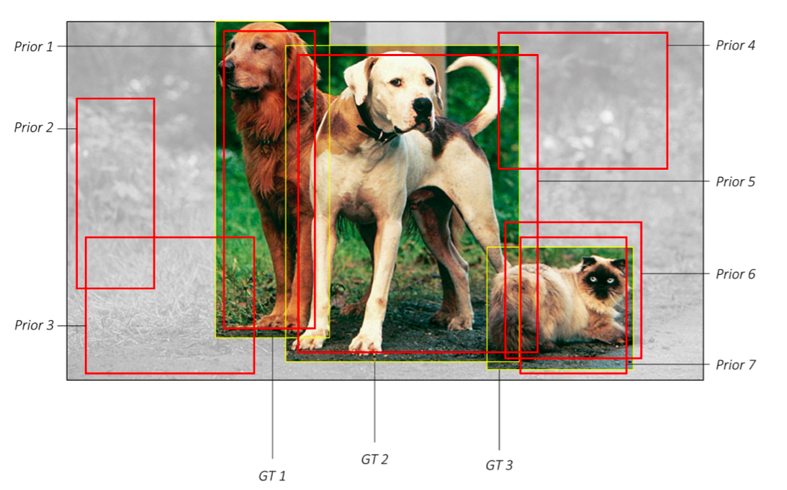
Region Based CNN (RCNN)
But what is the target for the classifier?

Slide 23
Region Based CNN (RCNN)
But what is the target for the classifier?
Some proposals will not match any ground truth object

Slide 24
Region Based CNN (RCNN)
But what is the target for the classifier?
Most will in-fact be background
Some proposals will not match any ground truth object

Slide 25
Region Based CNN (RCNN)
But what is the target for the classifier?
Some ground truth objects will be matched to two priors/proposals/anchor boxes

Slide 26
Region Based CNN (RCNN)
But what is the target for the classifier?
There will be class imbalance:
As most proposals will be background
We will usually sample so that proposals that are background but difficult to classify as background are considered while training.

Slide 27
Region Based CNN (RCNN)
 | GT1 | GT2 | GT3 | Background
P1 | True | False | False | False
P2 | True | False | False | False
P3 | False | True | False | False
P4 | False | False | False | True

Slide 28
Region Based CNN (RCNN)
 | C1 | C2 | C3 | Background
P1 | True | False | False | False
P2 | True | False | False | False
P3 | False | True | False | False
P4 | False | False | False | True

Slide 29
Region Based CNN (RCNN)
But what is the target for the classifier?
Training the model to identify more than one match for an object
Some ground truth objects will be matched to two priors/proposals/anchor boxes

Slide 30
Region Based CNN (RCNN)
RCNN use selective search to choose regions to be fed into a classifier and regressor
Around 2000 proposals are selected
A separate classifier finds out the class associated with each proposal
A separate regressor finds out the bounding box coordinates of each proposal that contains an object
These are then resized and pushed through a cnn

Slide 31
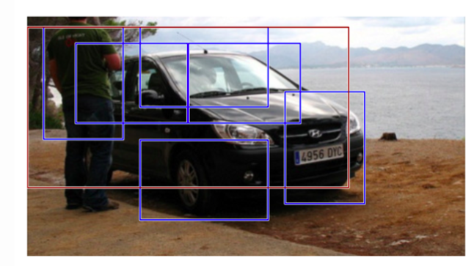
Region Based CNN (RCNN)
RCNN use selective search to choose regions to be fed into a classifier and regressor
There can be more than one output for each object

Slide 32
Region Based CNN (RCNN)
RCNN use selective search to choose regions to be fed into a classifier and regressor
Non Maximum Suppression: After we get a set of matched bounding boxes for the same object category: Sort all the bounding boxes by confidence score. Discard boxes with low confidence scores. While there is any remaining bounding box, repeat the following: Greedily select the one with the highest score. Skip the remaining boxes with high IoU (i.e. > 0.5) with previously selected one.
There can be more than one output for each object
Use Non Maximum Suppression

Slide 33
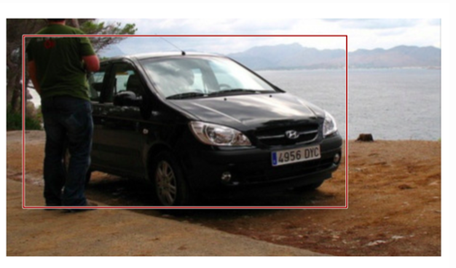
Region Based CNN (RCNN)
RCNN use selective search to choose regions to be fed into a classifier and regressor
Non Maximum Suppression: After we get a set of matched bounding boxes for the same object category: Sort all the bounding boxes by confidence score. Discard boxes with low confidence scores. While there is any remaining bounding box, repeat the following: Greedily select the one with the highest score. Skip the remaining boxes with high IoU (i.e. > 0.5) with previously selected one.
There can be more than one output for each object
Use Non Maximum Suppression

Slide 34
Region Based CNN (RCNN)
This model was the first attempt to use CNN to do object detection.
Selective search is very slow
Classifier and Regressors are trained separately
Not used any more, but newer architectures borrow ideas from this

Slide 35
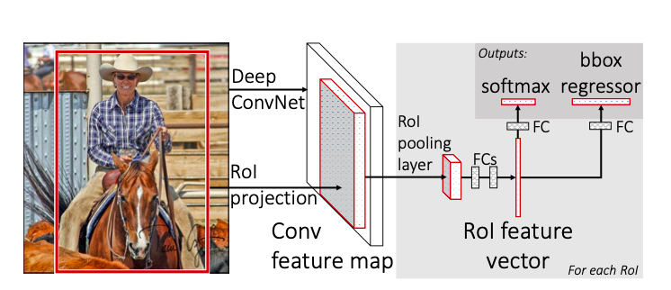
Fast RCNN
Fast RCNN uses ROI pooling (Region of Interest Pooling)

Slide 36
Fast RCNN
Selective search generates proposals

Slide 37
Fast RCNN
Selective search generates proposals
The image is passed through the pretrained CNN

Slide 38
Fast RCNN
Selective search generates proposals
The image is passed through the pretrained CNN
On this output and the region proposals ROI Pooling layer is applied

Slide 39
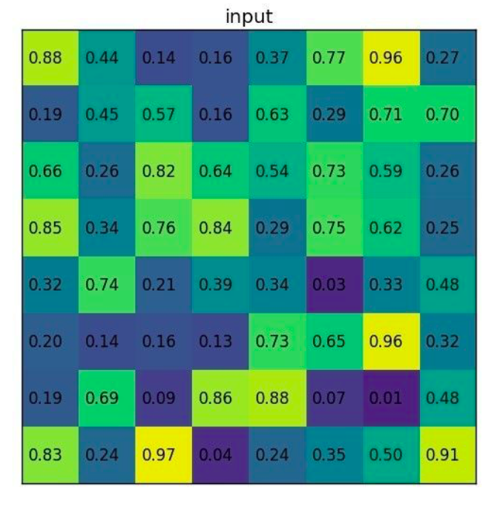
Fast RCNN

Slide 40
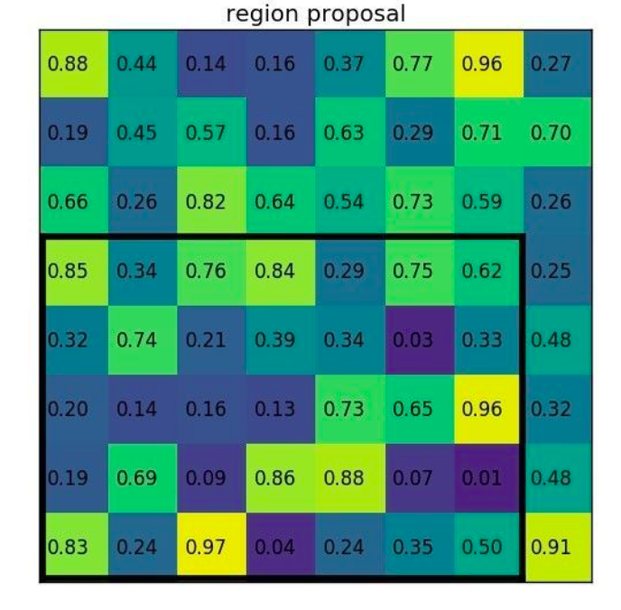
Fast RCNN

Slide 41
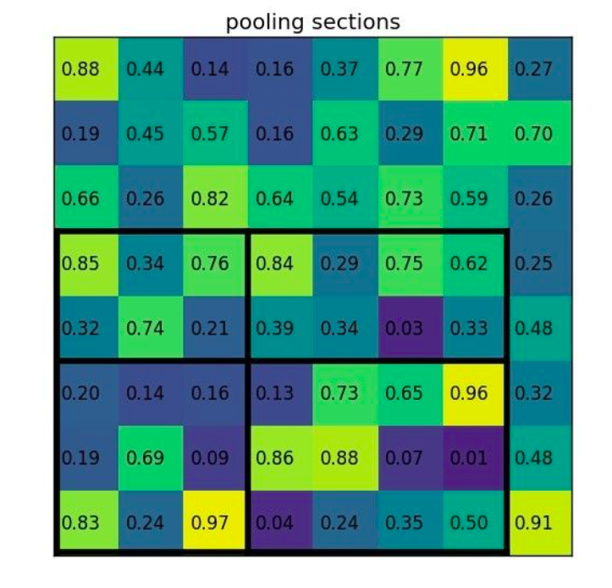
Fast RCNN

Slide 42
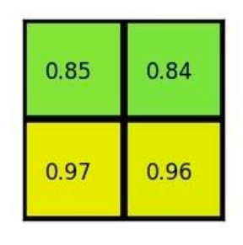
Fast RCNN

Slide 43
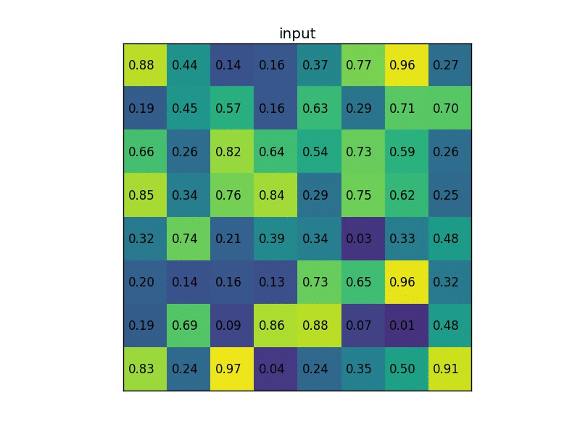
Fast RCNN

Slide 44
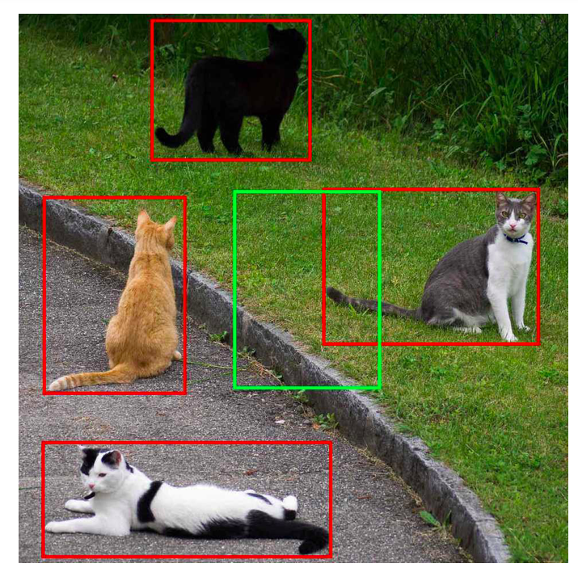
Fast RCNN

Slide 45
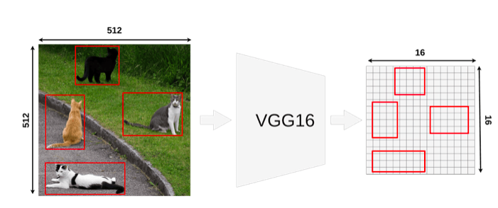
Fast RCNN

Slide 46
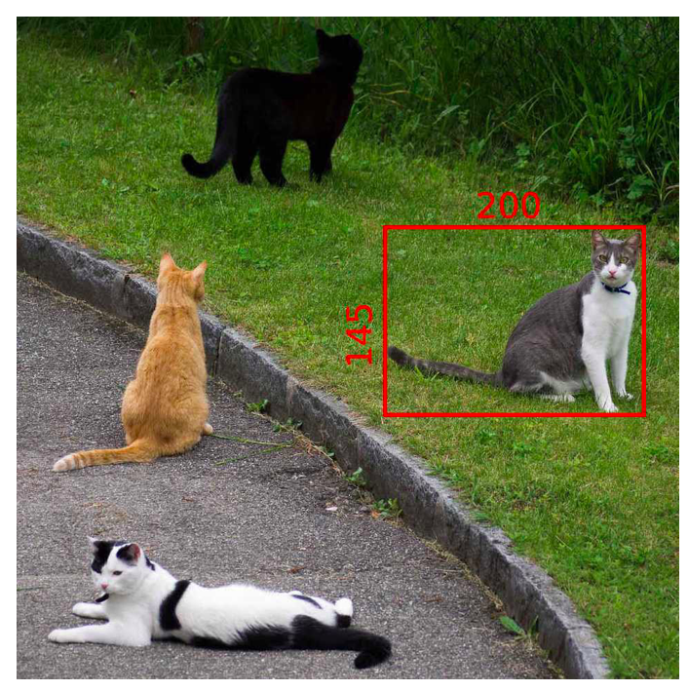
Fast RCNN

Slide 47
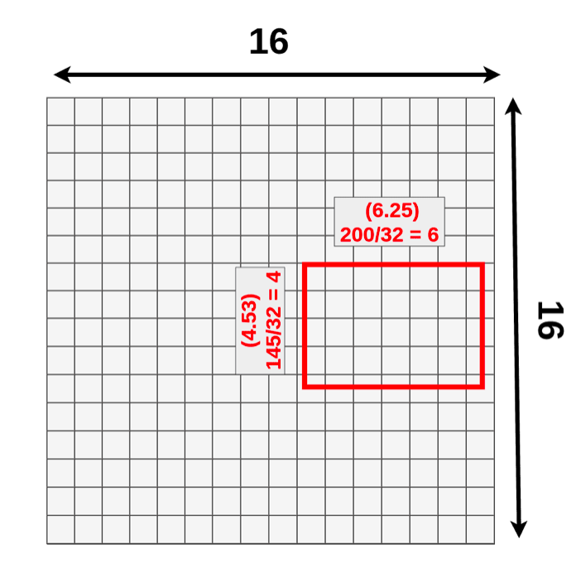
Fast RCNN

Slide 48
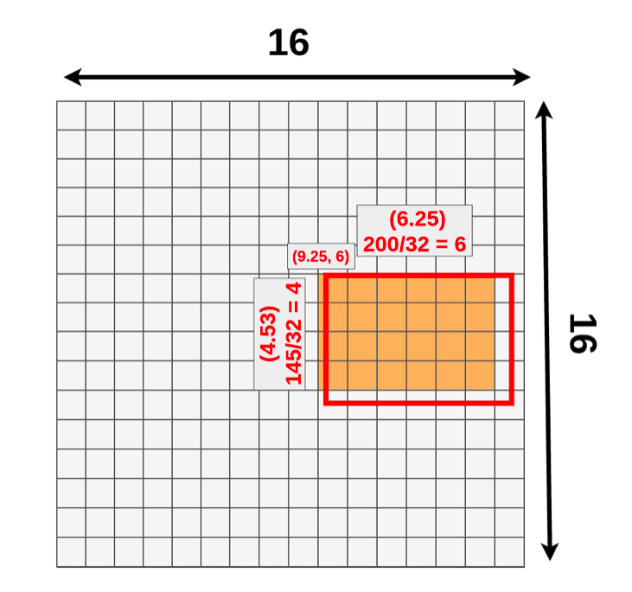
Fast RCNN

Slide 49
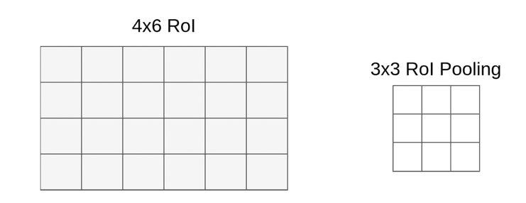
Fast RCNN

Slide 50
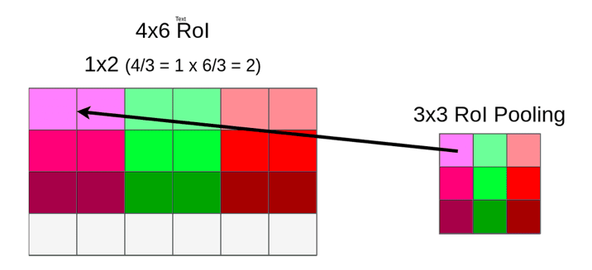
Fast RCNN

Slide 51
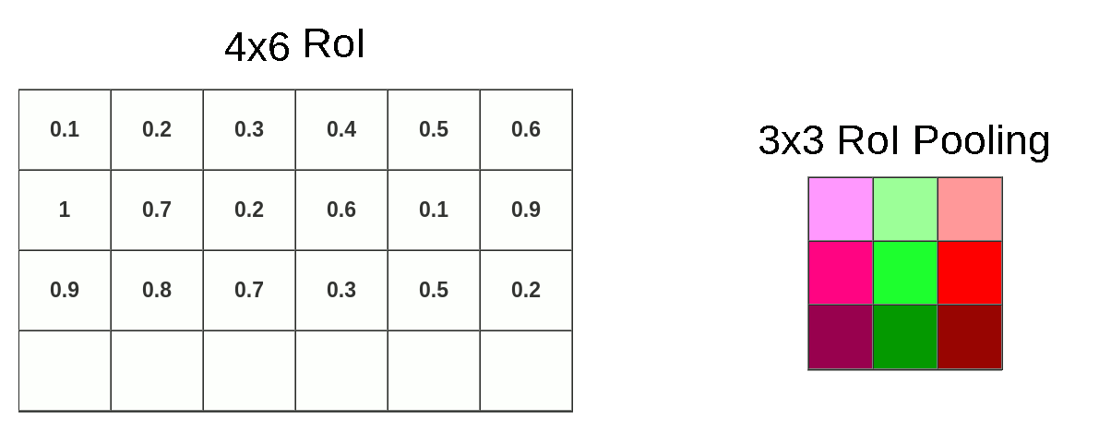
Fast RCNN

Slide 52
Fast RCNN
Selective search generates proposals
The image is passed through the pretrained CNN
On this output and the region proposals ROI Pooling layer is applied
Output from ROI pooling is flattened and is consumed by a classifier and a regressor.

Slide 53
Fast RCNN
Since image is pushed through a conv block unlike 2000 region proposals in RCNN, this reduces the computation time.
ROI pooling is computationally less expensive
It outputs same sized features which can be consumed again classifier and regressor.
But the selective search is still computationally very expensive

Slide 54
Faster RCNN
This introduced region proposal network.
Selective search is computationally expensive, RPN, helps in learning region proposal creation.

Slide 55
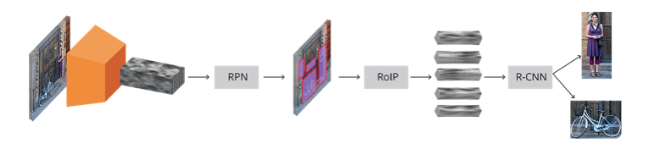
Faster RCNN
1000*600 input
VGG16
RPN
Fast RCNN

Slide 56
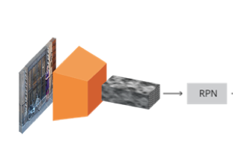
Faster RCNN
RPN learns how to create good region proposals

Slide 57
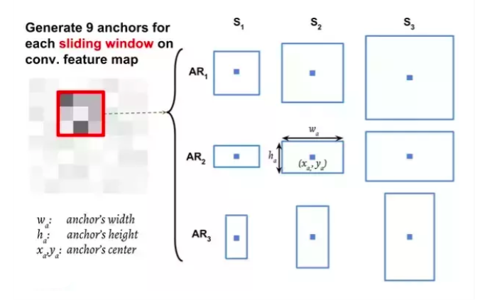
Faster RCNN

Slide 58
Faster RCNN
Scale: 8 (64px)
Scale: 16 (128px)
Scale: 32 (256px)
Ratio:1
Ratio: 2
Ratio: 0.5

Slide 59
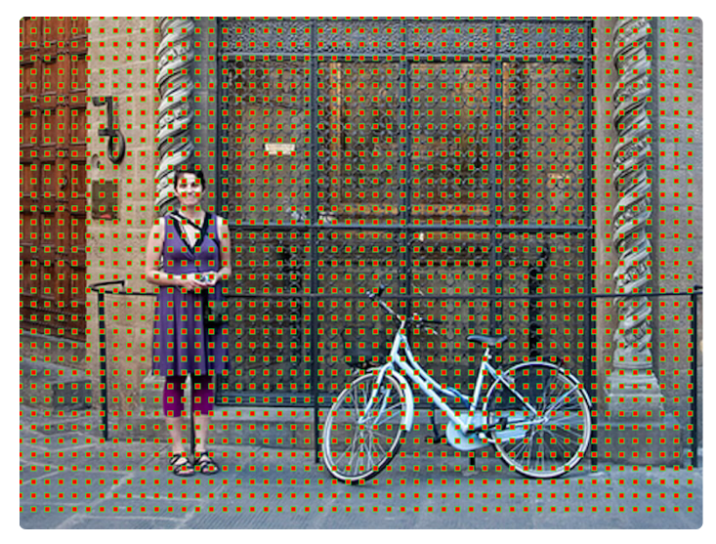
Faster RCNN
Each point in the output feature can be traced back to the input. (https://medium.com/syncedreview/a-guide-to-receptive-field-arithmetic-for-convolutional-neural-networks-42f33d4378e0)

Slide 60
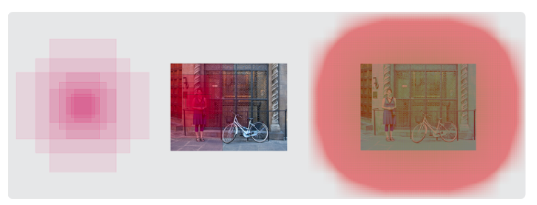
Faster RCNN

Slide 61
Faster RCNN
A1
A2
A3
A4
A5
A6
A7
A8
A9
A10
Conv feature
RPN
Obj1
Obj2
Obj3
Obj4

Slide 62
Faster RCNN
A1
A2
A3
A4
A5
A6
A7
A8
A9
A10
Conv feature
A1=>Good proposal
A2=>Bad proposal
A3=>Good proposal
A4=>Good proposal
A5=>Bad proposal
A6=>Bad proposal
A7=>Good proposal
A8=>Good proposal
A9=>Good proposal
A10=>Bad proposal
RPN

Slide 63
Single Shot detectors
Unlike, FRCNN and its predecessors, there is no elaborate proposal creation mechanism
Proposals are generated using heuristics
Much faster inference

Slide 64
YoloV3
YoloV3 is one of the faster object detectors
It relies on the idea of anchor boxes, chosen smartly.
One of the SOTA models when it comes to deployment on the edge or embedded devices.

Slide 65
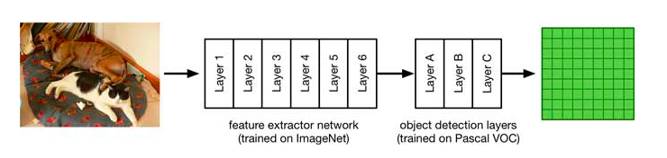
YoloV3 Architecture
416*416 images
13*13 features

Slide 66
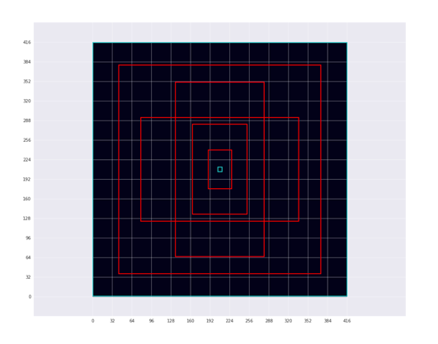
YoloV3 Architecture

Slide 67
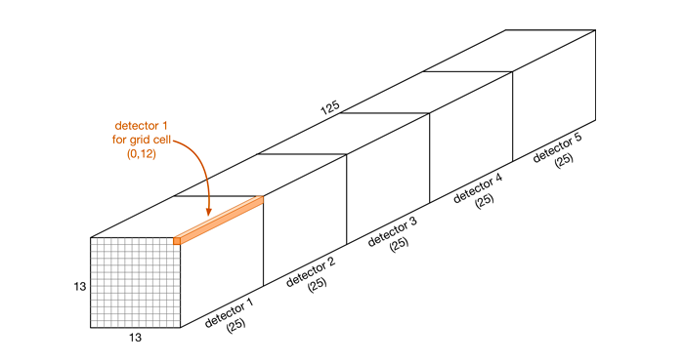
YoloV3 Final Layer
4 coordinates
20 class scores
Confidence score

Slide 68
YoloV3: Regression
We don’t attempt to predict absolute values of the bounding box coordinates.
The aim is to predict the offset of the actual boxes from the anchors.
tx = actual_x-anchor_x
ty = actual_y-anchor_y
tw=log(actual_width/anchor_width)
th=log(actual_height/anchor_height)

